Slide 1
Singleton Pattern in Ruby
By Niranjan Sarade

Slide 2

What is a Design Pattern ?

Slide 3
In software engineering, a design pattern is a general reusable solution to a commonly
occurring problem within a given context in software design.
Identifying Raga from a Song !
GOF book (Design Patterns: Elements of Reusable Object-Oriented Software)
- Gamma, Helm, Johnson, & Vlissides

Slide 4
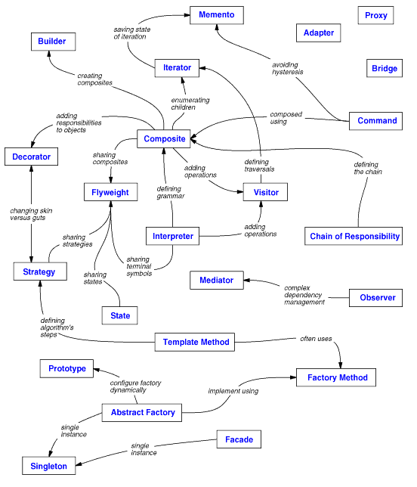

Slide 5
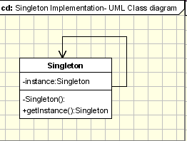
Singleton is one of the Creational Design patterns.
Ensure that only one instance of a class is created and provide a global access point to the object.

Slide 6
Applicability
- one database connection
- one LDAP connection
- one logger instance
- one configuration object for your application

Slide 7
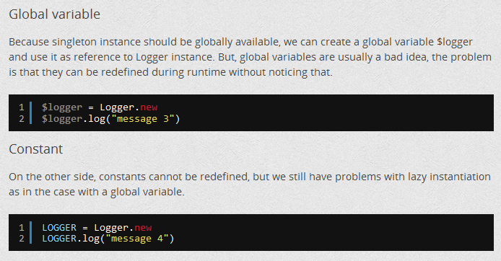
Alternative ways of implementing similar functionality to Singleton Pattern

Slide 8
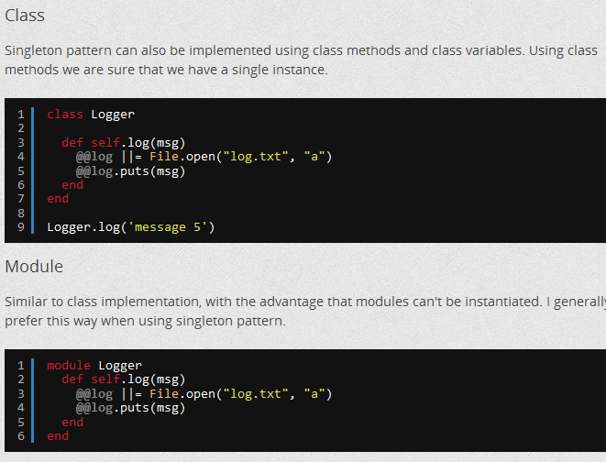

Slide 9
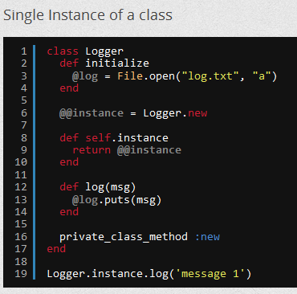
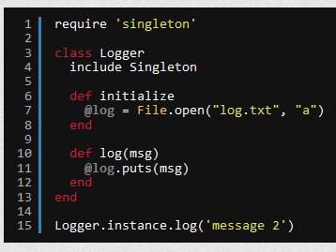

Slide 10
require 'singleton'
class MyClass
attr_accessor :data
include Singleton
end
a = MyClass.instance
b = MyClass.instance
#both a and b point to the same object
a.data=1234
b.data #also prints out 1234

Slide 11
Mixing in the Singleton module makes the "new" method private and
creates an “instance" method that returns the sole instance of MyClass.
MyClass.new
#=>private method `new’ called for MyClass:Class
a.dup
#=>can’t dup instance of singleton MyClass

Slide 12
require 'singleton'
class SimpleLogger
include Singleton
attr_accessor :level
ERROR=1
WARNING=2
INFO=3
def initialize
@log = File.open("log.txt", "w")
@level = WARNING
end
def error(msg)
@log.puts(msg)
@log.flush
end
def warning(msg)
@log.puts(msg) if @level >= WARNING
@log.flush
end
def info(msg)
@log.puts(msg) if @level >= INFO
@log.flush
end
end
logger = SimpleLogger.instance
logger.level = SimpleLogger::INFO
logger.info('Doing the first thing')
logger.info('Doing the second thing')

Slide 13
Observers in Rails
def instantiate_observers
return if @observers.blank?
@observers.each do |observer|
if observer.respond_to?(:to_sym) # Symbol or String
observer.to_s.camelize.constantize.instance
elsif observer.respond_to?(:instance)
observer.instance
else
raise ArgumentError, "#{observer} must be a lowercase, underscored class name (or an instance of the class itself) responding to the instance method. Example: Person.observers = :big_brother # calls BigBrother.instance"
end
end
end

Slide 14
Inflectors in Rails
# Yields a singleton instance of Inflector::Inflections so you can specify additional
# inflector rules.
#
# Example:
# ActiveSupport::Inflector.inflections do |inflect|
# inflect.irregular 'person', 'people'
# end
def inflections
if block_given?
yield Inflections.instance
else
Inflections.instance
end
end

Slide 15
References
http://rubylearning.com/blog/2010/11/02/how-does-one-use-design-patterns-in-ruby/
http://designpatternsinruby.com/section01/article.html
http://khelll.com/blog/ruby/observer-and-singleton-design-patterns-in-ruby/
http://dalibornasevic.com/posts/9-ruby-singleton-pattern-again
http://stackoverflow.com/questions/1482605/what-is-the-correct-way-to-write-a-singleton-pattern-in-ruby
http://c2.com/cgi/wiki?RubySingleton
http://www.oodesign.com

Slide 16
Thank You !

